Slide 1

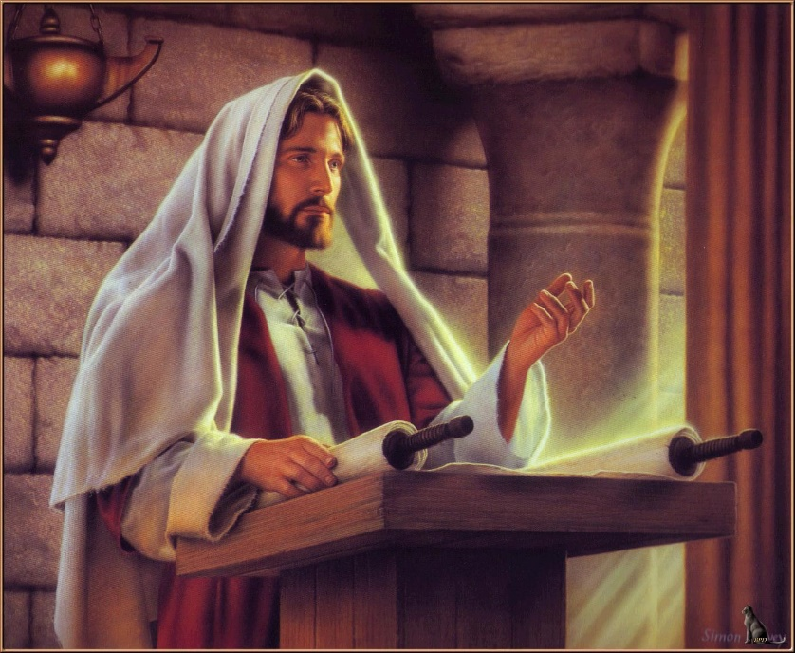
再充满我

Slide 2
愿我心成为你圣灵的圣殿
May my heart be your temple to the Holy Spirit
愿我灵感到你拥抱的温暖
May I inspire you to embrace the warmth
愿我成为一个圣洁的居所
May I become a holy place
让你圣灵乐意居住
To make your Holy Spirit willing to live
1-1

Slide 3
愿我心成为你圣灵的圣殿
May my heart be your temple to the Holy Spirit
愿我灵感到你拥抱的温暖
May I inspire you to embrace the warmth
愿我成为一个圣洁的居所
May I become a holy place
让你圣灵乐意居住
To make your Holy Spirit willing to live
1-2

Slide 4
主我渴望更认识你荣耀
Lord I long to know you more gloriously
我要向你献上赞美的祭
I will offer you a praise
求你再一次，用圣灵充满这殿
Again, fill this temple with the Holy Spirit
1-3

Slide 5
愿我心成为你圣灵的圣殿
May my heart be your temple to the Holy Spirit
愿我灵感到你拥抱的温暖
May I inspire you to embrace the warmth
愿我成为一个圣洁的居所
May I become a holy place
让你圣灵乐意居住
To make your Holy Spirit willing to live
1-4

Slide 6
主我渴望更认识你荣耀
Lord I long to know you more gloriously
我要向你献上赞美的祭
I will offer you a praise
求你再一次，用圣灵充满这殿
Again, fill this temple with the Holy Spirit
1-5

Slide 7

主我渴望更认识你荣耀
Lord I long to know you more gloriously
我要向你献上赞美的祭
I will offer you a praise
求你再一次，用圣灵充满这殿
Again, fill this temple with the Holy Spirit
求你再一次，用圣灵充满这殿
Again, fill this temple with the Holy Spirit
1-6

